Slide 1

AI-Driven Analysis of Pilgrim Experiences: Enhancing Hajj and Umrah Services Through Smart Data Insights

Slide 2
Abstract
The Hajj and Umrah pilgrimage sectors struggle to process and extract valuable insights from the vast amount of feedback they receive—around 30 million comments each year in more than 27 languages. The high volume and linguistic diversity of these reviews make it challenging for authorities to sort and address recurring concerns systematically.
This project aims to introduce an AI-powered solution using pre-trained transformer models, such as GPT, to analyze pilgrim feedback efficiently. The system will categorize comments into key service areas, including immigration, accommodation, transportation, and public services, while also assessing sentiment to determine overall satisfaction levels.
Furthermore, the AI model’s performance will be measured using accuracy, precision, recall, and F1-score metrics to ensure its reliability. By adopting this approach, authorities can obtain data-driven insights to enhance the pilgrimage experience, improve service quality, and make more informed decisions.

Slide 3
Project Description
The proposed project aims to develop an AI-powered analytics system capable of processing and categorizing large-scale pilgrim feedback data. The primary objective is to leverage Natural Language Processing (NLP) and pre-trained transformer models to analyze text-based reviews and identify key areas that require service enhancements.

Slide 4
Beneficiaries
Pilgrims – Improved services based on data-driven enhancements will lead to a more seamless and satisfactory pilgrimage experience.
Ministry of Hajj and Umrah – Access to AI-generated insights will allow for informed decision-making and targeted service improvements.
Service Providers – Hotels, transportation companies, and healthcare services can refine their offerings based on real-time feedback analysis.
AI & Data Science Researchers – The project will provide a case study on applying AI to large-scale multilingual sentiment and topic classification.

Slide 5
Research Questions
How can pre-trained transformer models, like GPT, analyze reviews from pilgrims to identify the main challenges they face?
How accurately can AI models classify pilgrims' comments as positive or negative?
What are the most common challenges pilgrims face based on AI-driven sentiment analysis, and which service areas require improvement?
How do the findings from AI-based analyses compare with previous studies regarding model accuracy?

Slide 6
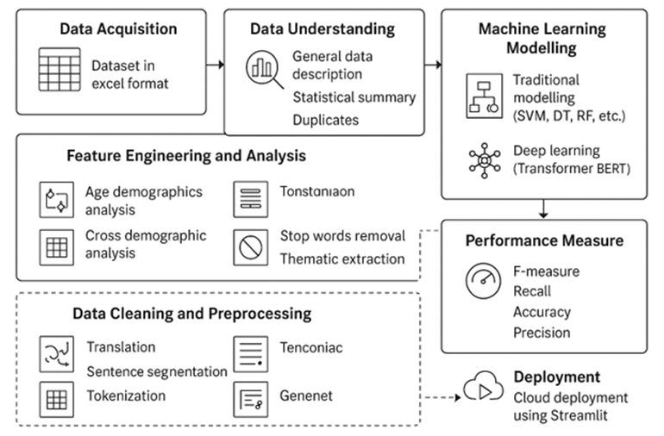
Project Methodology
Structural Design and Architecture

Slide 7
Datasets/Data Collection
Dataset Used: Comments and Feedback from Pilgrimages
Data Collection: from database

Slide 8
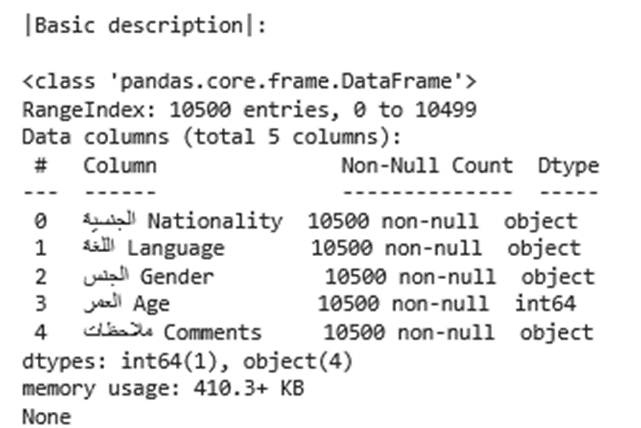
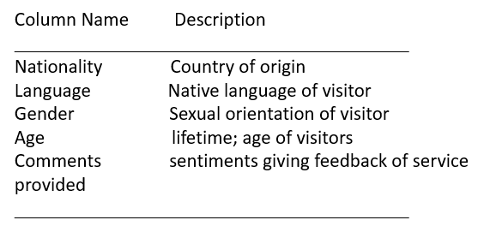
Data Description
The tables shows the basic data description including what each column represents, data type, number of observations, and memory usage

Slide 9
Data Mining/Cleaning/Preprocessing
Normalization: Long sentence comments segmentation to enhance readability, capitalization, and punctuation
Tokenization: Sentence comments segmentation to fundamental units; words, tokens
Stop word removal: removing common and useless words
Thematic extraction: Generating service categories from comments
Feature Engineering and Transformation: Variables isolation into a new dataset with demographic variables

Slide 10
Analytic Techniques
Machine Learning Models:
Gensim Models
LDA, Latent Dirichlet Allocation
CoherenceModel
Deep Learning Models:
AutomodelForSequenceClassifications
Distilbert-base-uncased-finetuned-sst-2-English
Bert-base-uncased
Comparison Metrics: Evaluation of performance using Precision, Recall, F1-score, and Accuracy scores

Slide 11
Statistics and Visualizations
Describe method: statistical summary of the dataset
Line graph showing Age demographic analysis with statistical markers
Interactive line graph showing age distribution
Bubble maps showing nationality and gender by mean age
Histogram showing demographics of nationality by gender
Interactive histogram showing demographic characteristics of age, gender, and nationality
Scatter plot showing distribution of confidence of sentimental analysis
Bar graph showing negative sentiments per department and service category

Slide 12
Summary: Main Tools Used in the Project
________________________________________
FUNCTIONS MAIN TOOLS
________________________________________
Programming Python 3.10
Data Processing Scikit-Learn, Pandas, Numpy,
Visualization Seaborn, Matplotlib, Plotly
Machine Learning Scikit-Learn
Deep Learning Hugging Face Transformer
Model Evaluation scikit-Learn, Torch
Text Analysis and Translation Nltk, Deep Translator, Gensim, Collections
Deployment Streamlit Cloud Community
Collaboration Git Bash and Git Hub
Further Analysis Pivotal Table in Excel Spreadsheet
________________________________________

Slide 13
Results
Summary Of Model Evaluation Performance Metrics
Text Classification And Sentimental Analysis Of The Model
Visual Of Confidence Distribution Showing Accuracy Of Model In Classification And Analysis
Bar Graph Of Negative Sentiment Distribution Showing Departments Facing Most Challenges
Theoretical Analysis Of The Correlation Between Previous Studies (Expert Analysis) And Model Accuracy

Slide 14
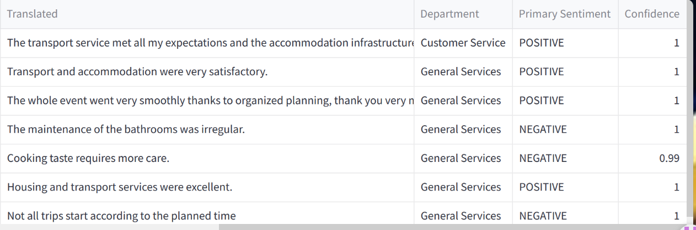
Output of Model Analysis
The output from the platform demonstrated pre-trained transformer models, like BERT, can analyze reviews from pilgrims, classify comments into service categories, and analyze the comments to identify the main challenges they face

Slide 15
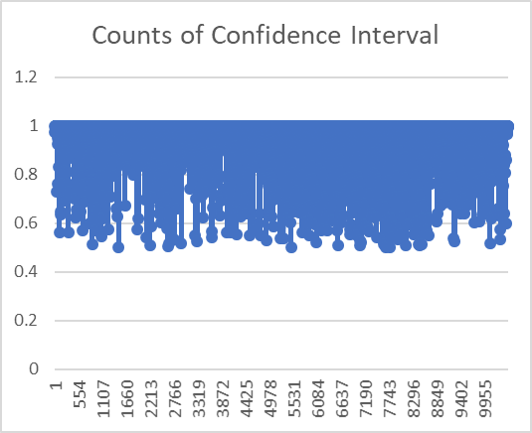
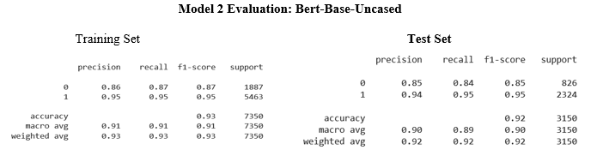
Left: Counts of Model Confidence in Text Analysis and Classification, confidence is clustered around 90-100 percent. Right: Summary of Precision, Recall, F1-Score, and Accuracy scores, the model is accurate with macro and average weights of at least 90 percent
The results show AI models can accurately classify pilgrims' comments as positive or negative.

Slide 16
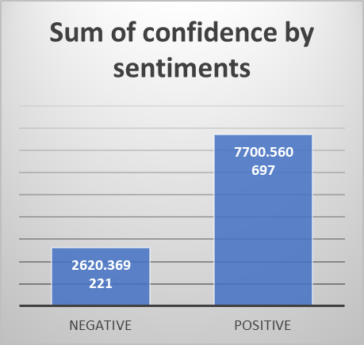
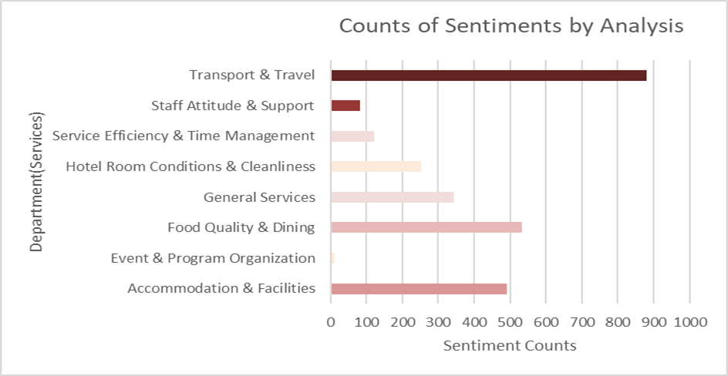
Graphs: Counts of Sentiments By Classification Analysis, From Left Pilgrims Experience is Mostly Positive.
Right: Negative Analysis of Sentiments Shows Transport and Travel Services are the Most Common Challenges Faced by Pilgrims
The size of bars shows the most common challenges (order of largest to smallest) pilgrims face based on AI-driven sentiment analysis and Service Areas requiring improvements.

Slide 17
Comparison of Model Accuracy with Previous Studies
Findings similar to studies by Chelloug et al. (2025), Firdos & Dermawan (2023), Bohn (2018), Bala (2022), Shah (2024), Subhan et al. (2023), and Amanah et al. (2021)
GPTs are better at generating content and transformers like BERT are accurate on sentiment and text analysis
modern and robust models are accurate, precise, and efficient in text classification and sentiment tasks
the accuracy of the models improves with model complexity.
There is a marginal alignment between AI-based analyses and expert analysis.
The findings from AI-based analyses compare similar with previous studies regarding model accuracy

Slide 18
Roadblocks and Challenges
Data quality issues: Possible biases in translating multilingual comments
Computational cost: high-performance hardware is required for big data and real-time analysis
Ethical concerns: Model bias in analyzing neutral sentiments

Slide 19
Limitations
Big data analysis and classification due computational costs.
Platform is limited to diverse validation because it relies on restricted data only applicable to the platform.
Analyzing neutral comments
Real-time analysis and classification

Slide 20
Recommendations
Future projects to consider addressing issues of scalability by utilizing more advanced mechanisms and domain-specific embeddings
Future projects integrate real-time analysis and use pretrained models like GPT

Slide 21
Conclusions
Customer sentiments and feedback provide valuable insights to improve services, identify challenges, and address customer experience
AI-Driven analysis of pilgrim experiences (using pretrained transformers like BERT or GPT) provide smart data insights that significantly can enhance accurately, effective, and efficient Hajj and Umrah services

Slide 22
References
Publications on AI, text classification, and sentiment analysis
Previous studies on model accuracy
Resources and dataset utilized in this study

